Slide 1

Tree Recursion
Week 4, Summer 2024. 7/10 (Wed)
Lecture 13

Slide 2
Announcements
Project01 (“Maps”) Checkpoint due tonight!
HW05, Lab05 due tonight!
(Important) Midterm exam scheduling!

Slide 3
Announcements: Midterm scheduling!
IMPORTANT: “Midterm Exam Scheduling” form was due on Gradescope last night (7/9)
IF YOU DIDN’T FILL IT OUT: we will send ONE MORE opportunity to schedule your midterm exam
If you miss this opportunity: we will assume you are taking the midterm at the “standard” slot: Wednesday July 17th, 2024, 3 PM – 5 PM PST
And, if you don’t attend this midterm slot: you won’t be taking the midterm
(reminder) midterm “clobber” policy: final can replace your midterm
(DSP students with +50% exam time) We have sent you a Google Form to schedule your exam. Please fill this out ASAP!

Slide 4
Midterm content
Midterm will cover content from start of course up to (and including) OOP+Inheritance, aka:
Start (inclusive): Lecture 01: “Welcome & Intro” (6/17)
End (inclusive): Lecture 15: “OOP – Inheritance” (7/15)
Midterm will be done through Zoom + Gradescope
Study tip: past C88C exams can be found here: https://c88c.org/sp24/articles/resources.html#past-midterms
Take a look to get a sense of what C88C exams tend to look like. (I highly, highly encourage this)
“Be prepared” – Boy Scouts
“Luck is when preparation meets opportunity” – Roman philosopher Seneca

Slide 5
Midterm logistics
The midterm will be held over Zoom + Gradescope
You must have your camera + screen sharing on during the entire exam, and we will be doing screen+camera recording.
You must take the exam in a quiet room with no other students present
Things to bring to the exam (and nothing else!):
Photo ID. Ideally your UCB student ID, but anything with your name + photo is fine, eg: Passport, driver’s license, etc.
(Optional) Five (5) pages of handwritten (not typed!) notes
(Optional, recommended) Additional blank scratch paper, pencil/pen/eraser.
We will provide everyone with a 1-2 page digital PDF of additional reference
Other than the above notes, the exam will be closed book, closed notes.
(For more info, stay tuned for an Ed post)

Slide 6
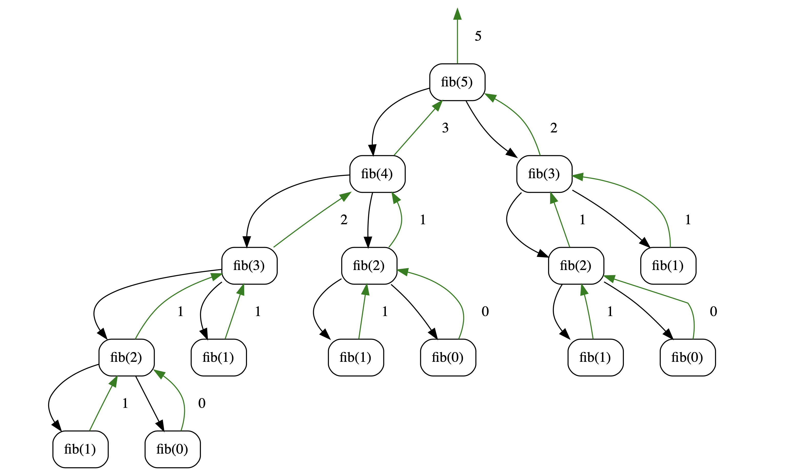
Today’s Lecture
Tree recursion
aka recursive functions that make multiple recursive calls per “level”
call stack looks like a “tree”
Function domain/range

Slide 7
Learning Objectives
Write Recursive functions with multiple recursive calls
Understand Recursive Fibonacci
Understand the the count_change algorithm
Bonus: Use multiple recursive calls in to sort a list.

Slide 8
Tree Recursion
Tree Recursion involves multiple recursive calls to solve a problem.
Drawing out a function usually looks like an “inverted” tree.
(optional) Revisit the "vee" program from lecture 11.
Many of these programs can't be written with iteration very easily
Tip: in principle, you can solve any problem with recursion or iteration. But, recursion can make some problems simpler.

Slide 9
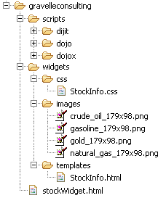
Example I
List all items on your hard disk
Files
Folders contain
Files
Folders
def process_directory(directory):
for item in directory:
if is_file(item):
process_file(item)
else:
process_directory(item)

Slide 10
The Fibonacci Sequence

Slide 11
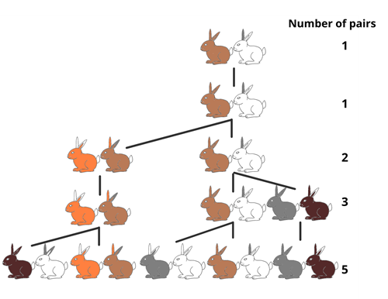
The Fibonacci Sequence
0, 1, 1, 2, 3, 5, 8, 13, 21, 34, 55, 89…
Fib(0) = 0, Fib(1) = 1
Fib(n) = Fib(n-1) + Fib(n-2)
Source: https://www.imaginationstationtoledo.org/about/blog/the-fibonacci-sequence

Slide 12
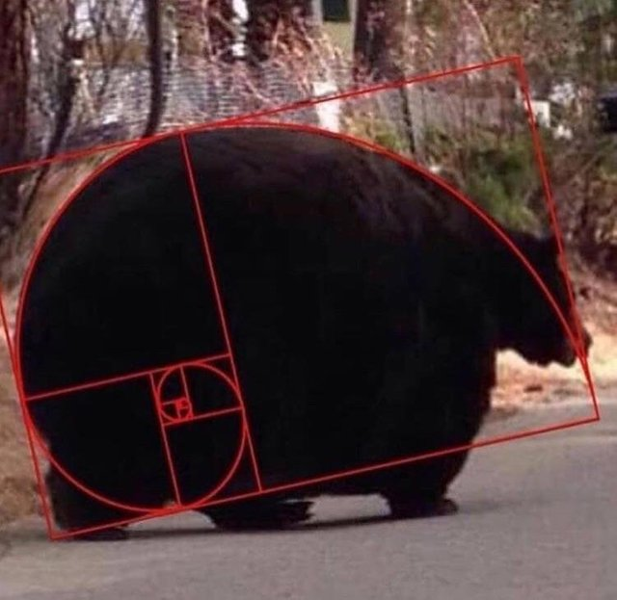
Golden Spirals Occur in Nature
GO BEARS

Slide 13
Fibonacci Code
fibonacci(n) = fibonacci(n-1) + fibonacci(n-2)
where fibonacci(1) == 1 and fibonacci(0) == 0
def fib(n):
"""
>>> fib(5)
5
"""
if n < 2:
return n
return fib(n - 1) + fib(n - 2)

Slide 14
Visualizing Fib Recursion:
Interactive View

Slide 15
But what about the iterative version?
In practice, recursive fib is slow!
We can write the program using a for loop.
How do we translate this? You've done it before!
Technique is called "dynamic programming". (covered in CS170)
def iter_fib(n):
(n_1, n_2) = (0, 1)
for i in range(0, n):
fib_next = n_1 + n_2
n_1 = n_2
n_2 = fib_next
# Note: below update is equivalent to above
# Computes n_1+n_2 before updating n_1
# (n_1, n_2) = (n_2, n_1 + n_2)
return n_1

Slide 16
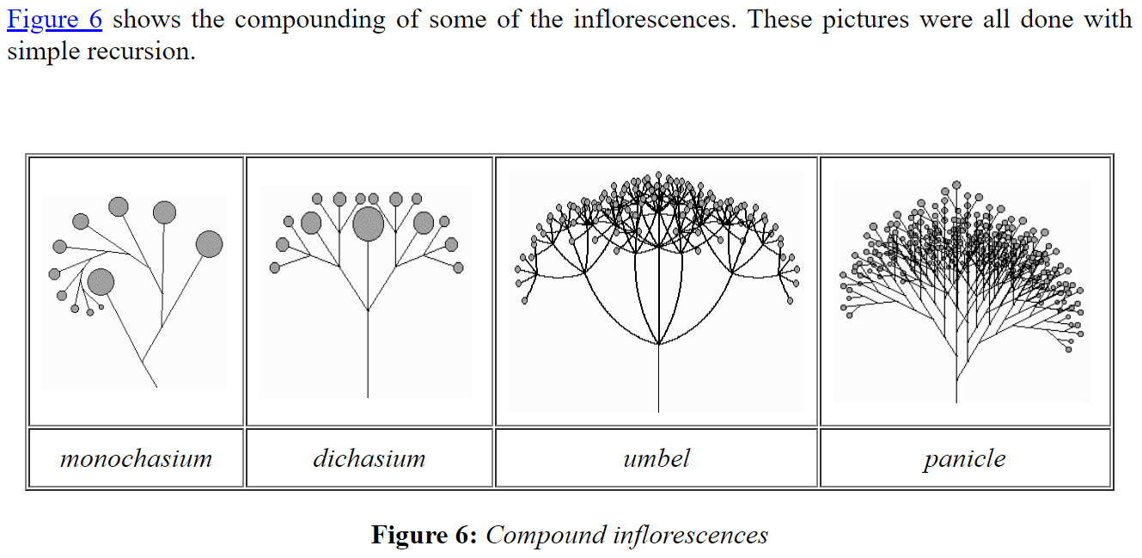
What's Similar to Fibonacci?
Many number sequences have similar properties
Catalan numbers
Pascal's Triangle
"Branching" Patterns in Biology:
(Real) Tree branches
Veins in leaves
Romanesco Broccoli
Population growth of animals over N generations
Some of these structures can be modeled recursively

Slide 17
Count Change

Slide 18
Counting Change
Problem Statement:
Given (an infinite number of) coins, (25¢, 10¢, etc) how many different ways can I represent 10¢?
e.g. 5¢ can be made 2 ways: 1 nickel, or 5 pennies
10¢ can be made 4 ways: [1x 10¢, 2x 5¢, 1 5¢ + 5 1¢, 10x 1¢]
Order doesn't matter, 5¢ + 5 1¢ is the same as 5 1¢ + 5¢
How do we calculate this?
Question: Put on our “recursion” hats, and ask: what is the recursive structure of this problem? (base cases, recursive cases)

Slide 19
Counting Change
change for 25¢ using [25, 10, 5] → 4
What are possible “smaller” problems?
Smaller amount of money → use coin
Fewer coins → “discard” coin
What is our base case?
valid count: value is 0 -> return 1
invalid count: value is < 0, or no coins left -> return 0
Recursion:
Divide: split into two problems (smaller amount & fewer coins)
Combine: addition (# of ways)

Slide 20
count_change code
def count_change(value, coins):
"""
>>> denominations = [50, 25, 10, 5, 1]
>>> count_change(7, denominations)
2
"""
if value < 0 or len(coins) == 0:
return 0
elif value == 0:
return 1
using_coin = count_change(value - coins[0], coins)
not_using_coin = count_change(value, coins[1:])
return using_coin + not_using_coin

Slide 21
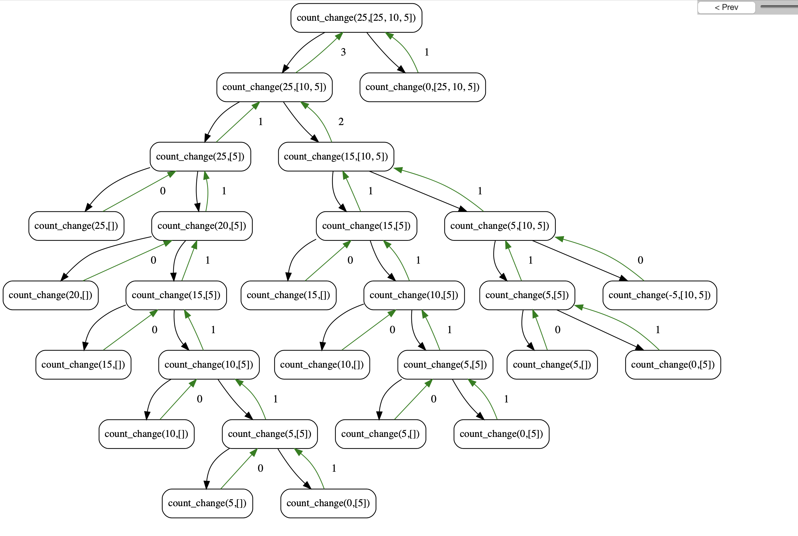
Visualizing Count Change
Interactive view

Slide 22
Why use problems like count change?
We're partitioning coins, but these could be bills, or other currency
Many tree recursive questions follow a similar recursive step
Notice how instead of a conditional, we combine the results of two possible options
We make recursive calls for all possible outcomes, then the base case(s) handle the conditional logic.

Slide 23
There are many more recursive problems!
The Knapsack Problem: Maximize the value of items thrown in a bag up to some "weight"
Anything relating to Family Trees, Relationships, Social Networks
Count the Nth degree of "followers of followers" of some one
Many of these involve graphs which you'll learn in CS61B
Subsets, Combinations, Permutations
Longest Common Subsequence of 2 sets
Imagine 2 words, or 2 strings of DNA

Slide 24
Exercise: map
Recall: map(fn, sequence) is a higher-order function that applies fn(item) to each item in sequence.
>>> map(lambda x: x * 2, [1, 2, 3])
[2, 4, 6]
def map_recurse(fn, seq):
# FILL ME IN
Question: re-implement map() as a recursive function, map_recurse(). Do not use for/while loops, list comprehensions, or the built-in map().
Hint: put on our “recursion” hat. What is the recursive structure? (base cases, recursive cases)

Slide 25
Exercise: map
Recall: map(fn, sequence) is a higher-order function that applies fn(item) to each item in sequence.
>>> map(lambda x: x * 2, [1, 2, 3])
[2, 4, 6]
def map_recurse(fn, seq):
if not seq:
return []
return [fn(seq[0])] + map_recurse(fn, seq[1:])
Base case:
Map-ing an empty list -> return empty list
Recursive case:
Apply `fn` to the first seq element, and concatenate this to the result of map-ing the rest of the sequence.

Slide 26
Exercise: map
(Visualization) Call stack
fn_square = lambda x: x * 2
map_recurse(fn_double, [1, 2, 3])
-> [fn_double(1)] + map_recurse(fn_double, [2, 3])
-> [fn_double(1)] + ([fn_double(2)] + map_recurse(fn_double, [3]))
-> [fn_double(1)] + ([fn_double(2)] + ([fn_double([3])] + map_recurse(fn_double, [])))
-> [fn_double(1)] + ([fn_double(2)] + ([fn_double([3])] + []))
-> [fn_double(1)] + ([fn_double(2)] + [6])
-> [fn_double(1)] + [4, 6]
-> [2] + [4, 6]
-> [2, 4, 6]
Base case! Empty list
def map_recurse(fn, seq):
if not seq:
return []
return [fn(seq[0])] + map_recurse(fn, seq[1:])

Slide 27
Exercise: “deep” map
Now, let’s look at `map_deep()`, where the input list can have nested lists. Notably, map_deep() should preserve the nested structure.
>>> map_deep(fn_square, [1, [2], [3, [4]]])
[2, [4], [6, [8]]]
Question: what is the recursive structure of this problem? (base cases, recursive cases)

Slide 28
Exercise: “deep” map
Now, let’s look at `map_deep()`, where the input list can have nested lists. Notably, map_deep() should preserve the nested structure.
>>> map_deep(fn_square, [1, [2], [3, [4]]])
[2, [4], [6, [8]]]
Compare to “shallow” map_recurse()
Base case:
Map-ing an empty list -> return empty list
Recursive case:
Apply `fn` to the first seq element, and concatenate this to the result of map-ing the rest of the sequence.
Base cases:
Map_deep()-ing an empty list -> return empty list
Recursive cases:
(First val) if the first element is a list, transform it via map_deep(). Else, transform it via fn()
Then, concatenate the transformed first val to the result to map_deep()-ing the rest of the list.
New: in map_deep(), we may perform a recursive call when transforming the first val.
In map_recurse() we simply apply fn() to the first val.

Slide 29
Tip: isinstance()
To implement map_deep(), first a tip: `isinstance(thing, type)` lets you check the type of an object/expression:
>>> isinstance([1, 2, 3], list)
>>> isinstance([1, 2, 3], dict)
>>> x = 42
>>> isinstance(x, int)

Slide 30
Exercise: “deep” map
def map_deep(fn, seq):
if not seq:
return []
else:
if isinstance(seq[0], list):
first_val = map_deep(fn, seq[0])
else:
first_val = fn(seq[0])
return [first_val] + map_deep(fn, seq[1:])

Slide 31
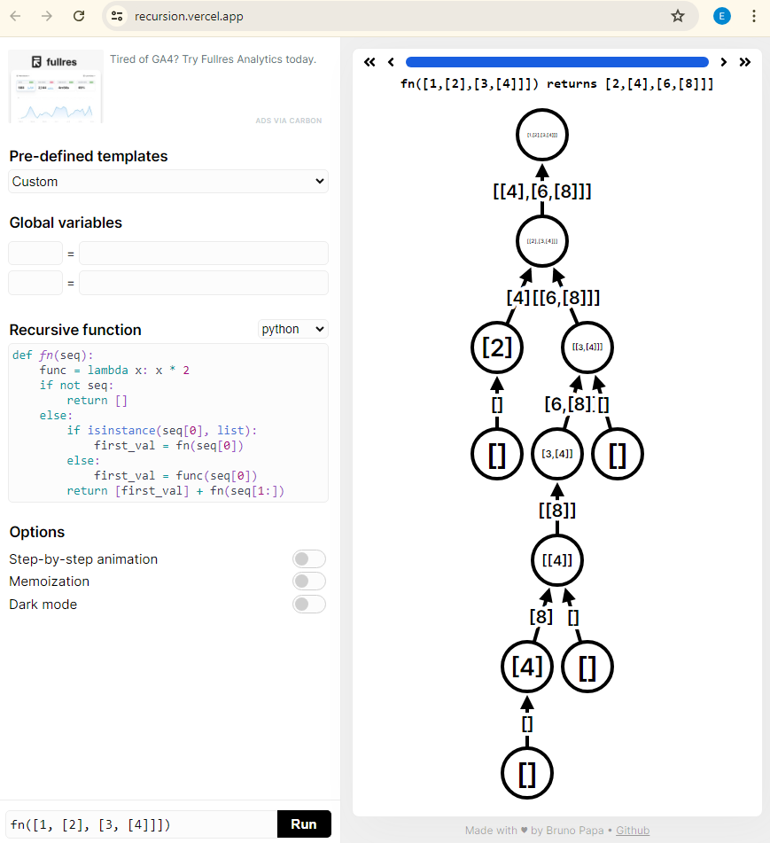
Visualization: map_deep
Link: https://recursion.vercel.app/
Tip: this website is a little finicky, limitations:
Function must be named fn()
Lambda arguments are not supported. So, I had to hard-code the square_fn in the function body
def fn(seq):
func = lambda x: x * 2
if not seq:
return []
else:
if isinstance(seq[0], list):
first_val = fn(seq[0])
else:
first_val = func(seq[0])
return [first_val] + fn(seq[1:])
fn([1, [2], [3, [4]]])

Slide 32
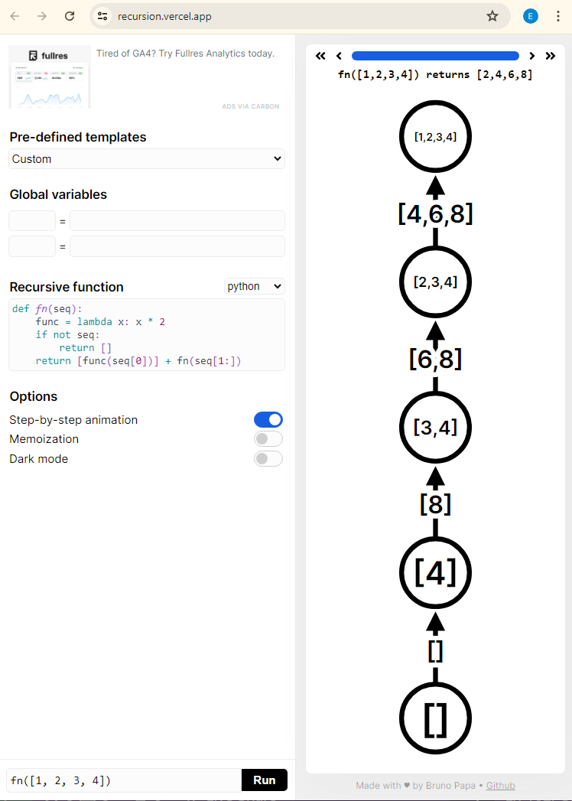
Visualization: map_deep vs shallow map
Observation: “Deep” map (LHS) looks like a “tree”, hence “Tree recursion”
“Shallow” map (RHS) has no “branches”.
def fn(seq):
func = lambda x: x * 2
if not seq:
return []
return [func(seq[0])] + fn(seq[1:])
fn([1, 2, 3, 4])
Link: https://recursion.vercel.app/

Slide 33
Tip: function “domain”, “range”
A handy tip about working with functions is to keep track of their expected inputs and outputs, aka “domain” and “range”
The domain of a function is the number and types a function accepts as input
The range of a function is the output type(s) that the function returns
def double_num(num):
"""
>>> double_num(42)
84
"""
# Domain: a number (eg int/float)
# Range: a number (int/float)
return num * 2
def sum_nums(nums):
"""
>>> sum_nums([1, 2, 3])
6
"""
# Domain: a List of numbers
# Range: a number
out = 0
for num in nums:
out += num
return out

Slide 34
Tip: function “domain”, “range”
A handy tip about working with functions is to keep track of their expected inputs and outputs, aka “domain” and “range”
The domain of a function is the number and types a function accepts as input
The range of a function is the output type(s) that the function returns
def map_recurse(fn, seq):
"""
>>> map_recurse(lambda x: x * 2, [1, 2, 3])
[2, 4, 6]
"""
# Domain: (arg1) function of one arg, (arg2) sequence
# Range: a sequence
if not seq:
return []
return [fn(seq[0])] + map_recurse(fn, seq[1:])
Question: what is the domain and range of this function?

Slide 35
Tip: function “domain”, “range”
When writing Python code (particularly tree recursion), my advice is to always keep track of and respect a function’s domain and range!
A common class of bugs (both in C88C, and in “the real world”) is:
(1) Calling a function with the wrong arg types, or
(2) Expecting a function returns type X, when it actually returns type Y

Slide 36

Tip: function “domain”, “range”
Example: let’s examine a buggy implementation of map_deep()
def map_deep_buggy(fn, seq):
# Domain: (arg1) function of one arg,
# (arg2) list of int OR nested list(s)
# Range: list
if not seq:
return []
else:
first_val = map_deep_buggy(fn, seq[0])
return first_val + map_deep_buggy(fn, seq[1:])
Bug: the `first_val` recursive call violates `map_deep_buggy()`’s domain, as we may pass a NUMBER instead of a LIST as the second arg.
Possible types: number, List
Question: I claim there is a bug in this code. Can you (1) identify the bug and (2) relate it to function domain and range?
This domain violation should ring alarm bells in your head that this implementation is wrong.

Slide 37
Tip: function “domain”, “range”
def map_deep_buggy(fn, seq):
# Domain: (arg1) function of one arg,
# (arg2) list of int OR nested list(s)
# Range: list
if not seq:
return []
else:
first_val = map_deep_buggy(fn, seq[0])
return first_val + map_deep_buggy(fn, seq[1:])
>>> map_deep_buggy(lambda x: x * 2, [1, [2, [3]]])
Traceback (most recent call last):
File "C:\Users\Eric\c88c\lectures\lecture13\lecture13.py", line 147, in <module>
print(map_deep_buggy(lambda x: x * 2, [1, [2, [3]]]))
File "C:\Users\Eric\c88c\lectures\lecture13\lecture13.py", line 144, in map_deep_buggy
first_val = map_deep_buggy(fn, seq[0])
File "C:\Users\Eric\c88c\lectures\lecture13\lecture13.py", line 144, in map_deep_buggy
first_val = map_deep_buggy(fn, seq[0])
TypeError: 'int' object is not subscriptable
Possible types: number, List
Explanation: We try to call `map_deep_buggy(fn, 1)`, which errors because we can’t subscript an integer: `1[0]` -> error.
This domain violation should ring alarm bells in your head that this implementation is wrong.
Tip: learn how to read and interpret Python error messages. Useful not only in C88C, but also your future classes + career.

Slide 38
(Aside) Python types
Python doesn’t have a strict static system like “statically typed” languages like Java, C/C++. Instead, it’s a dynamically typed language.
Consequence: in Python, we can accidentally pass the wrong types into functions. This isn’t possible in statically-typed languages like Java/C/C++
def map_shallow(fn, lst):
# Domain: (arg1) function of one arg
# (arg2) list
# Range: list
if not lst:
return []
return [fn(lst[0])] + map_shallow(fn, lst[1:])
>>> map_shallow(lambda x: x * 2, 42)
…
line 144, in map_deep_buggy
first_val = map_deep_buggy(fn, seq[0])
TypeError: 'int' object is not subscriptable

Slide 39
(Aside) Python type annotation hints
In your future Python work, you may enjoy annotating functions with their domain/range via python3.5+’s built-in type-annotation hints (typing package)
from typing import List, Callable
def map_shallow_typehint(fn: Callable, lst: List[int]) -> List:
# Domain: (arg1) function of one arg
# (arg2) list
# Range: list
if not lst:
return []
return [fn(lst[0])] + map_shallow_typehint(fn, lst[1:])
>>> map_shallow(lambda x: x * 2, 42)
…
line 144, in map_deep_buggy
first_val = map_deep_buggy(fn, seq[0])
TypeError: 'int' object is not subscriptable
`List[int]` means “a list of integers.
`List` implies “a list with elements of unknown type”
Callable: if you know the exact input/output types ahead of time, you can do:
`Callable[[input_type_1, …], out_type]`
Some IDE’s (eg VSCode, PyCharm) can interpret these type-hints and warn you if you are passing in the wrong types!
Note: this slide is NOT required for this class.
Take care: type-hints don’t actually do anything, the above error will still happen. Aka a “fancy comment”

Slide 40
Today’s Lecture. Any questions?
Tree recursion
aka recursive functions that make multiple recursive calls per “level”
call stack looks like a “tree”
Function domain/range

Slide 41
Quicksort

Slide 42
Quicksort
A fairly simple to sorting algorithm
Goal: Sort the list by breaking it into partially sorted parts
Pick a “pivot”, a starting item to split the list
Remove the pivot from your list
Split the list into 2 parts, a smaller part and a bigger part
Then recursively sort the smaller and bigger parts
Combine everything together: the smaller list, the pivot, then the bigger list

Slide 43
QuickSort Example
[3, 3, 1, 4, 5, 4, 3, 2, 1, 17]
Smaller than pivot (unsorted)
Larger than pivot (unsorted)
[3, 1, 3, 2, 1]
[4, 5, 4, 17]
[1, 3, 2, 1]
[]
[4]
[5, 17]
[1]
[3, 2]
[]
[]
[]
[17]
[]
[]
[2]
[]
[4]
[]
[]
[1]
[]
[]
[5, 17]
[2, 3]
[4, 4, 5, 17]
[1, 1, 2, 3]
Original (top level) pivot
[1, 1, 2, 3, 3]
[1, 1, 2, 3, 3, 3, 4, 4, 5, 17]
Smaller than pivot (sorted)
Larger than pivot (sorted)

Slide 44
Tree Recursion
Break the problem into multiple smaller sub-problems, and Solve them recursively
def split(x, s):
return [i for i in s if i <= x], [i for i in s if i > x]
def quicksort(s):
"""Sort a sequence - split it by the first element,
sort both parts and put them back together."""
if not s:
return []
else:
pivot = s[0]
smaller, bigger = split(pivot, s[1:])
return quicksort(smaller) + [pivot] + quicksort(bigger)
>>> quicksort([3,3,1,4,5,4,3,2,1,17])
[1, 1, 2, 3, 3, 3, 4, 4, 5, 17]

Slide 45
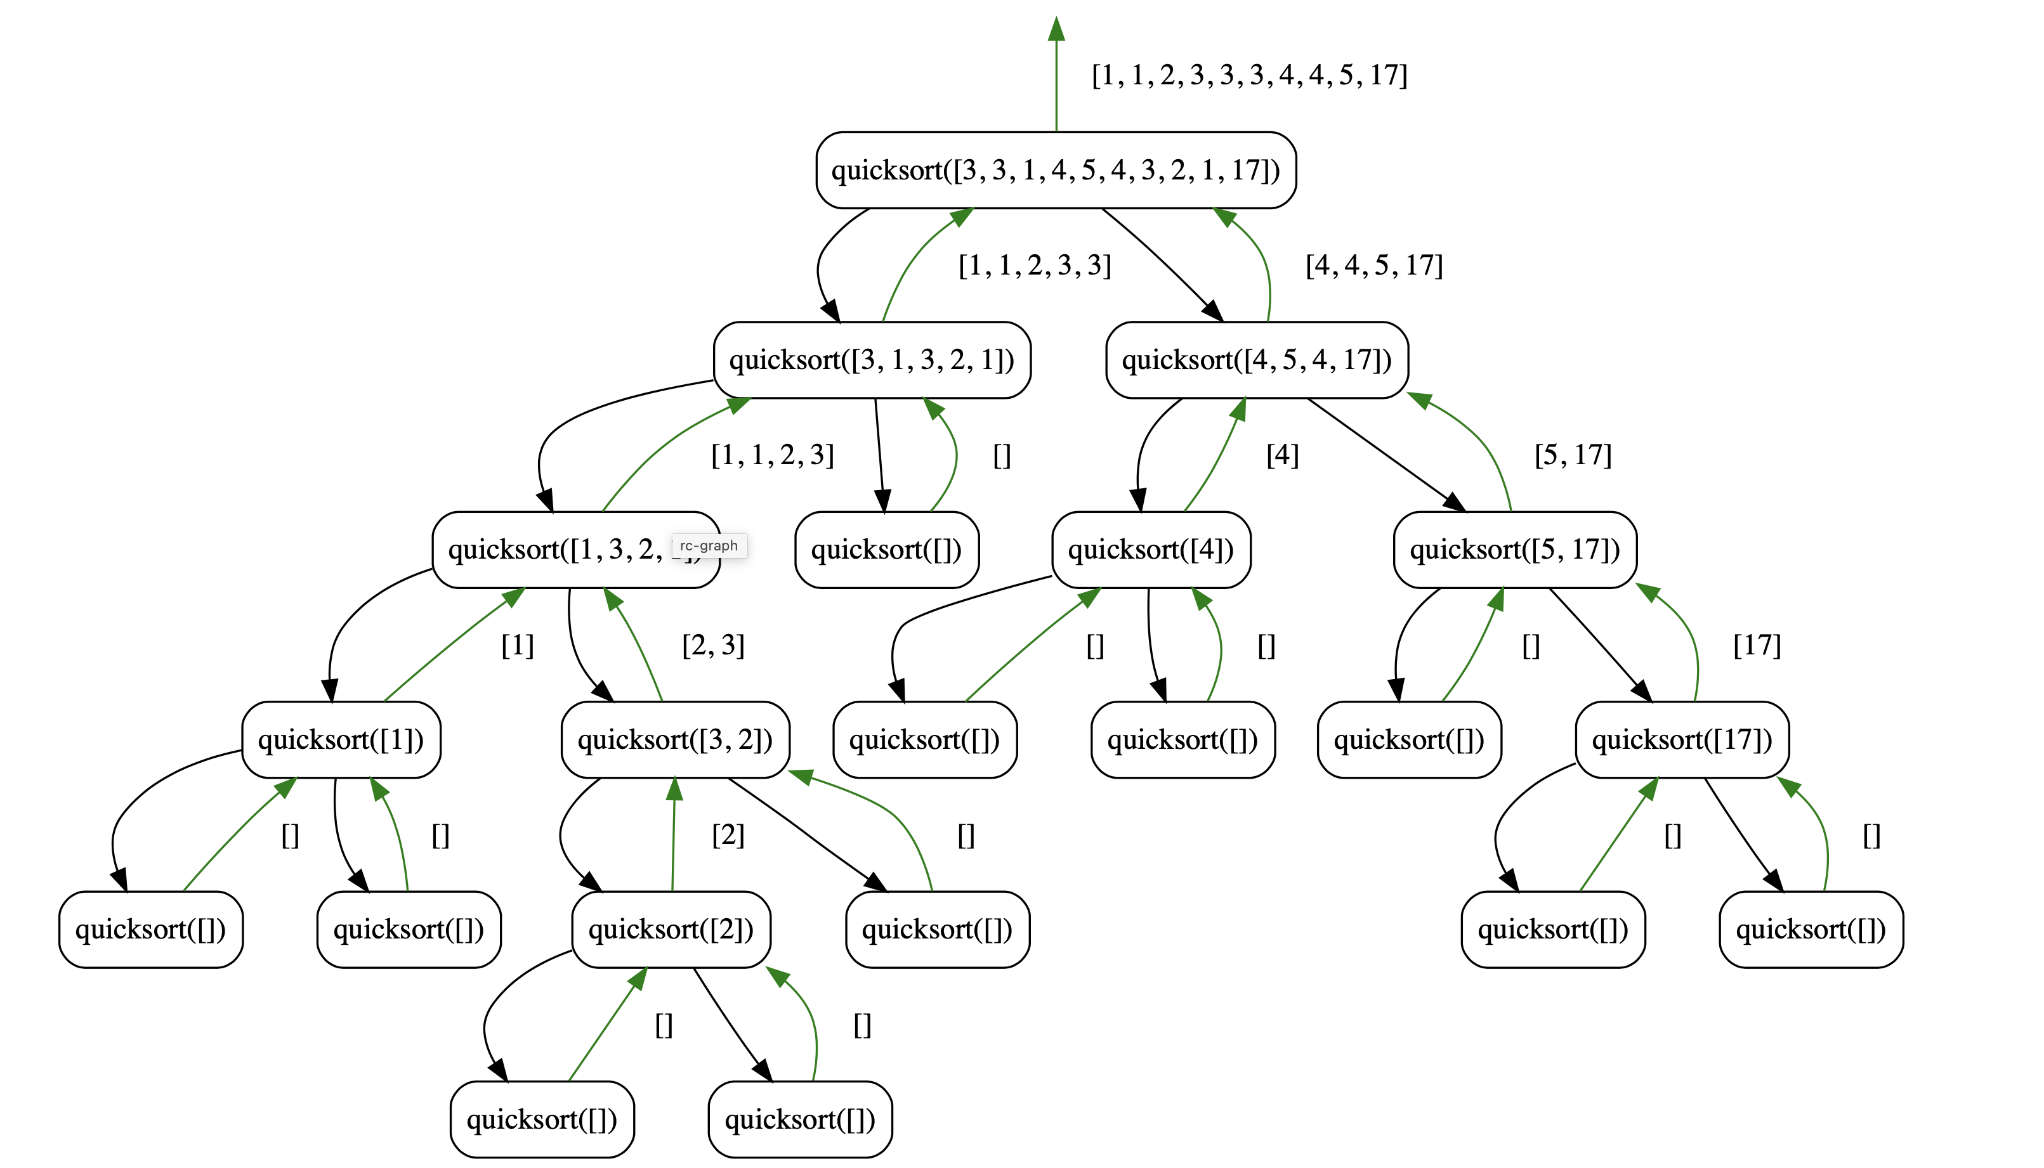
Quicksort Visualization
https://recursion.vercel.app/

